Slide 1
Chapter 5: CPU Scheduling

Slide 2
Chapter 5: CPU Scheduling
Basic Concepts
Scheduling Criteria
Scheduling Algorithms
Thread Scheduling
Multi-Processor Scheduling
Real-Time CPU Scheduling
Operating Systems Examples
Algorithm Evaluation

Slide 3
Objectives
Describe various CPU scheduling algorithms
Assess CPU scheduling algorithms based on scheduling criteria
Explain the issues related to multiprocessor and multicore scheduling
Describe various real-time scheduling algorithms
Describe the scheduling algorithms used in the Windows operating system
Apply modeling and simulations to evaluate CPU scheduling algorithms

Slide 4
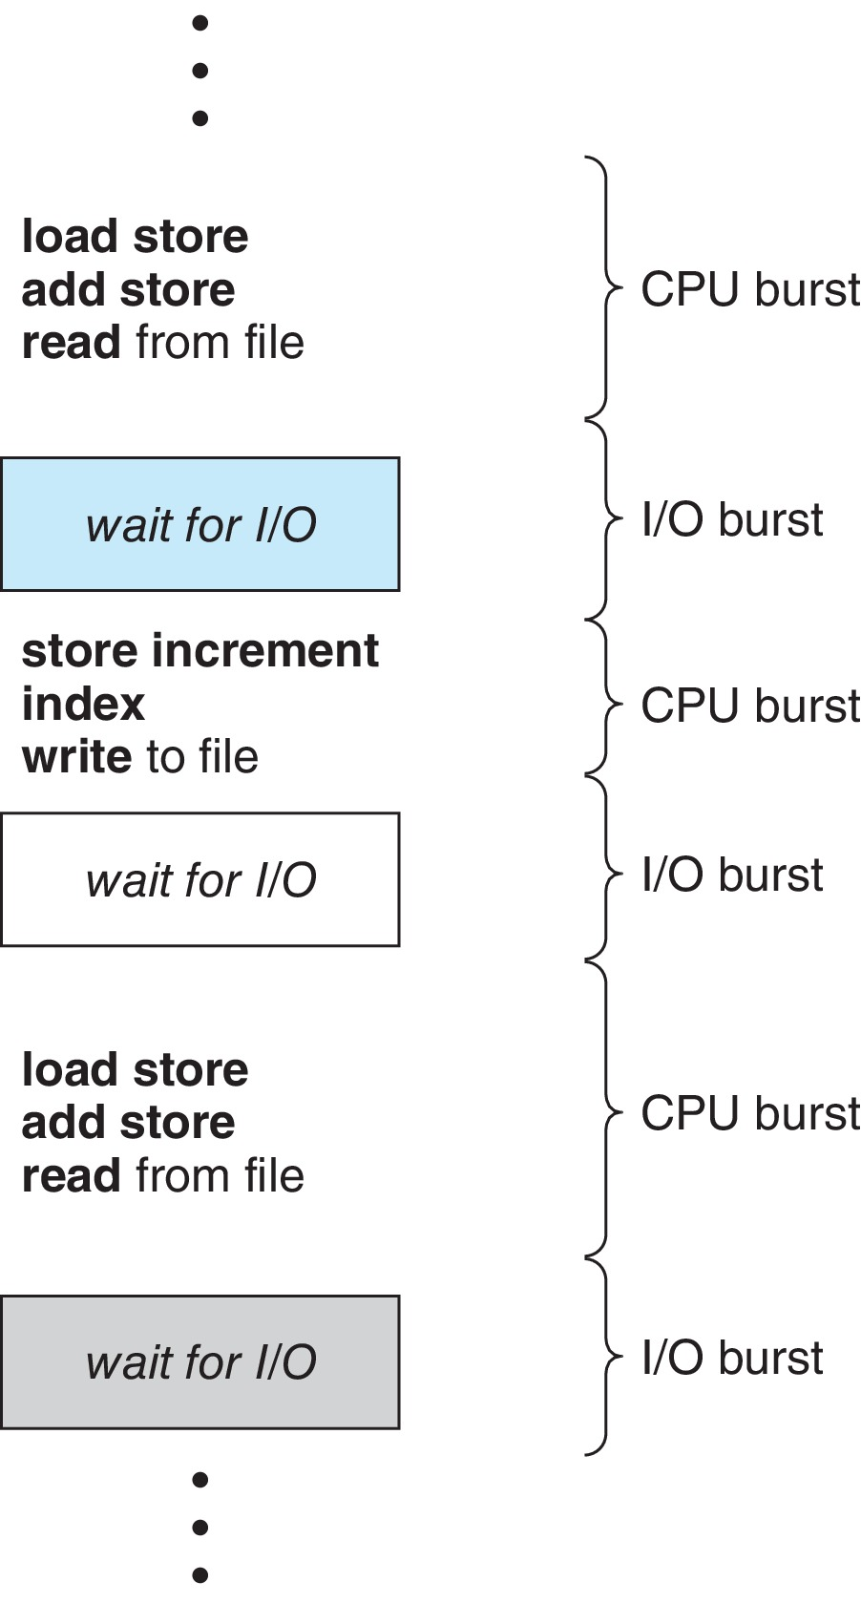
Basic Concepts
Maximum CPU utilization obtained with multiprogramming
CPU–I/O Burst Cycle – Process execution consists of a cycle of CPU execution and I/O wait
CPU burst followed by I/O burst
CPU burst distribution is of main concern

Slide 5
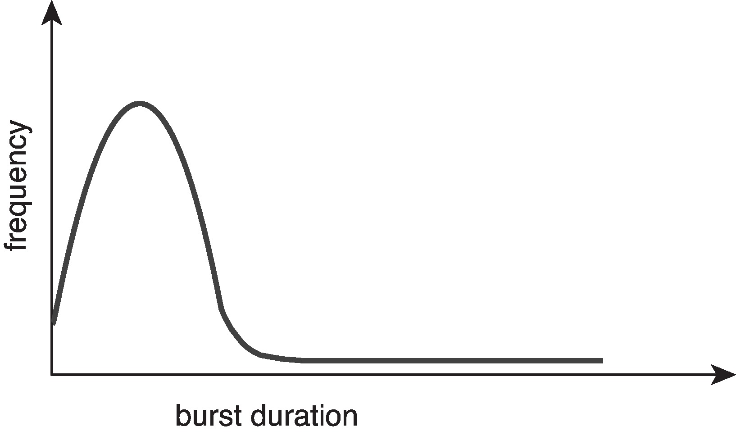
Histogram of CPU-burst Times
Large number of short bursts
Small number of longer bursts

Slide 6
CPU Scheduler
The CPU scheduler selects from among the processes in ready queue, and allocates the a CPU core to one of them
Queue may be ordered in various ways
CPU scheduling decisions may take place when a process:
1. Switches from running to waiting state
2. Switches from running to ready state
3. Switches from waiting to ready
Terminates
Scheduling under 1 and 4 is nonpreemptive
All other scheduling is preemptive
Consider access to shared data
Consider preemption while in kernel mode
Consider interrupts occurring during crucial OS activities

Slide 7
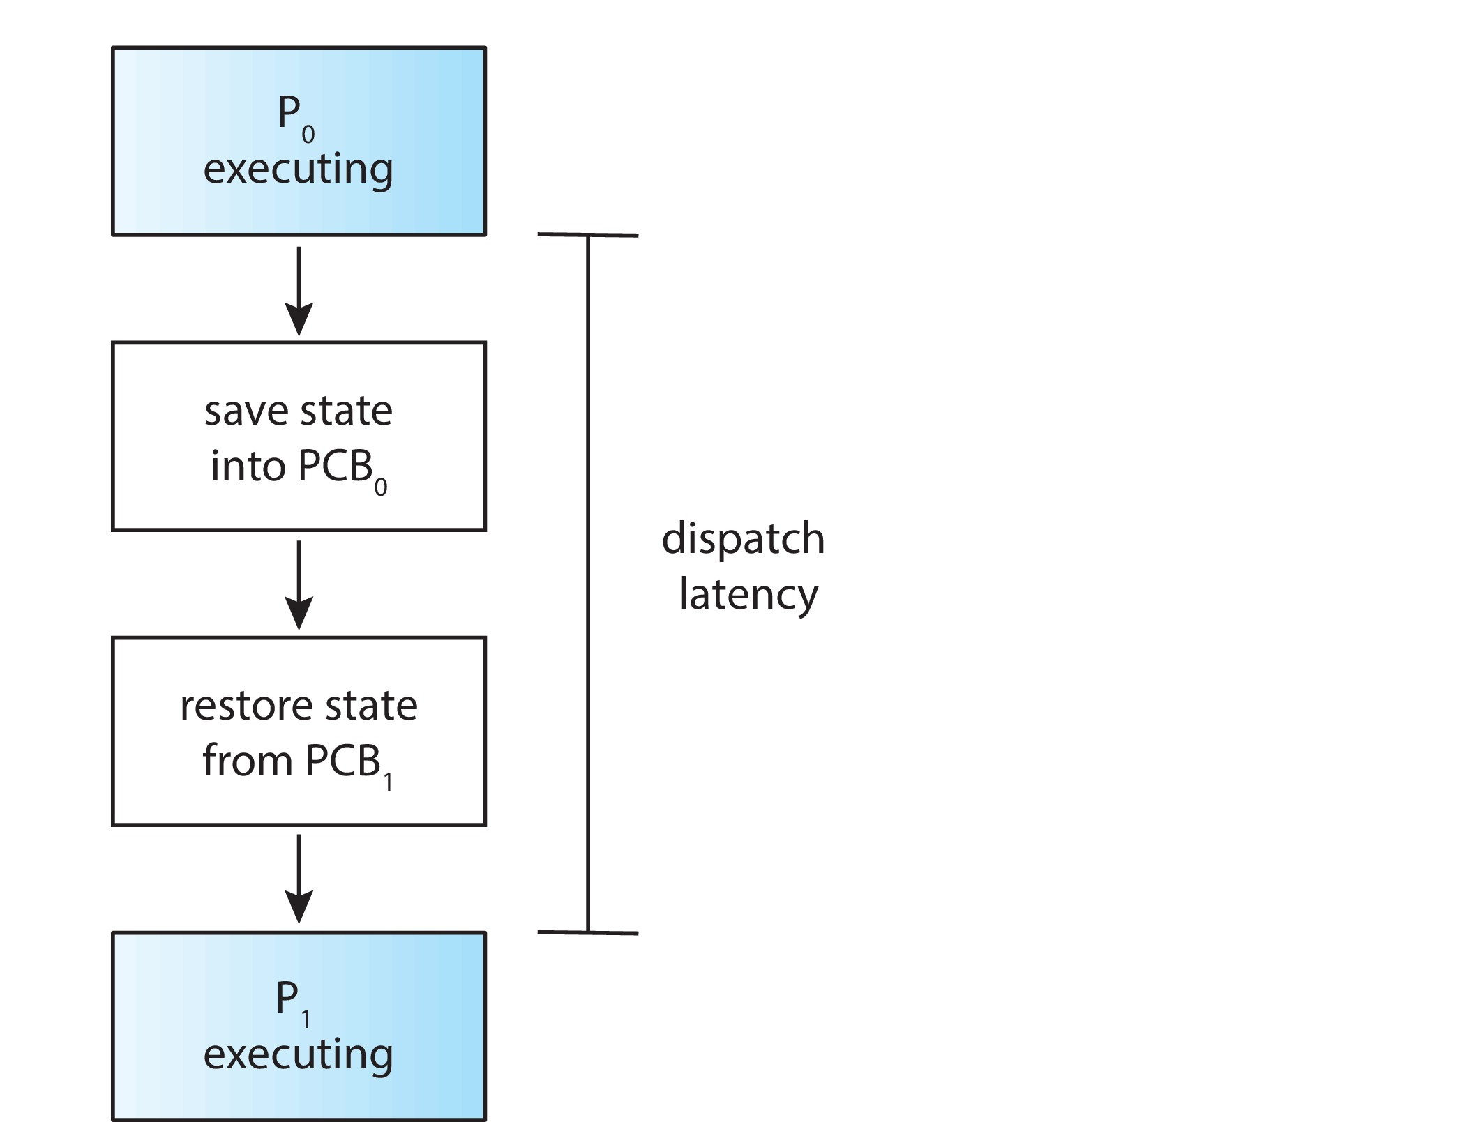
Dispatcher
Dispatcher module gives control of the CPU to the process selected by the short-term scheduler; this involves:
switching context
switching to user mode
jumping to the proper location in the user program to restart that program
Dispatch latency – time it takes for the dispatcher to stop one process and start another running

Slide 8
Scheduling Criteria
CPU utilization – keep the CPU as busy as possible
Throughput – # of processes that complete their execution per time unit
Turnaround time – amount of time to execute a particular process
Waiting time – amount of time a process has been waiting in the ready queue
Response time – amount of time it takes from when a request was submitted until the first response is produced, not output (for time-sharing environment)

Slide 9
Scheduling Algorithm Optimization Criteria
Max CPU utilization
Max throughput
Min turnaround time
Min waiting time
Min response time

Slide 10
First- Come, First-Served (FCFS) Scheduling
Process Burst Time
P₁ 24
P₂ 3
P₃ 3
Suppose that the processes arrive in the order: P₁ , P₂ , P₃ The Gantt Chart for the schedule is:
Waiting time for P₁ = 0; P₂ = 24; P₃ = 27
Average waiting time: (0 + 24 + 27)/3 = 17

Slide 11
FCFS Scheduling (Cont.)
Suppose that the processes arrive in the order:
P₂ , P₃ , P₁
The Gantt chart for the schedule is:
Waiting time for P₁ = 6; P₂ = 0; P₃ = 3
Average waiting time: (6 + 0 + 3)/3 = 3
Much better than previous case
Convoy effect - short process behind long process
Consider one CPU-bound and many I/O-bound processes

Slide 12
Shortest-Job-First (SJF) Scheduling
Associate with each process the length of its next CPU burst
Use these lengths to schedule the process with the shortest time
SJF is optimal – gives minimum average waiting time for a given set of processes
The difficulty is knowing the length of the next CPU request
Could ask the user

Slide 13
Example of SJF
ProcessArriva l Time Burst Time
P₁ 0.0 6
P₂ 2.0 8
P₃ 4.0 7
P₄ 5.0 3
SJF scheduling chart
Average waiting time = (3 + 16 + 9 + 0) / 4 = 7

Slide 14

Determining Length of Next CPU Burst
Can only estimate the length – should be similar to the previous one
Then pick process with shortest predicted next CPU burst
Can be done by using the length of previous CPU bursts, using exponential averaging
Commonly, α set to ½
Preemptive version called shortest-remaining-time-first

Slide 15
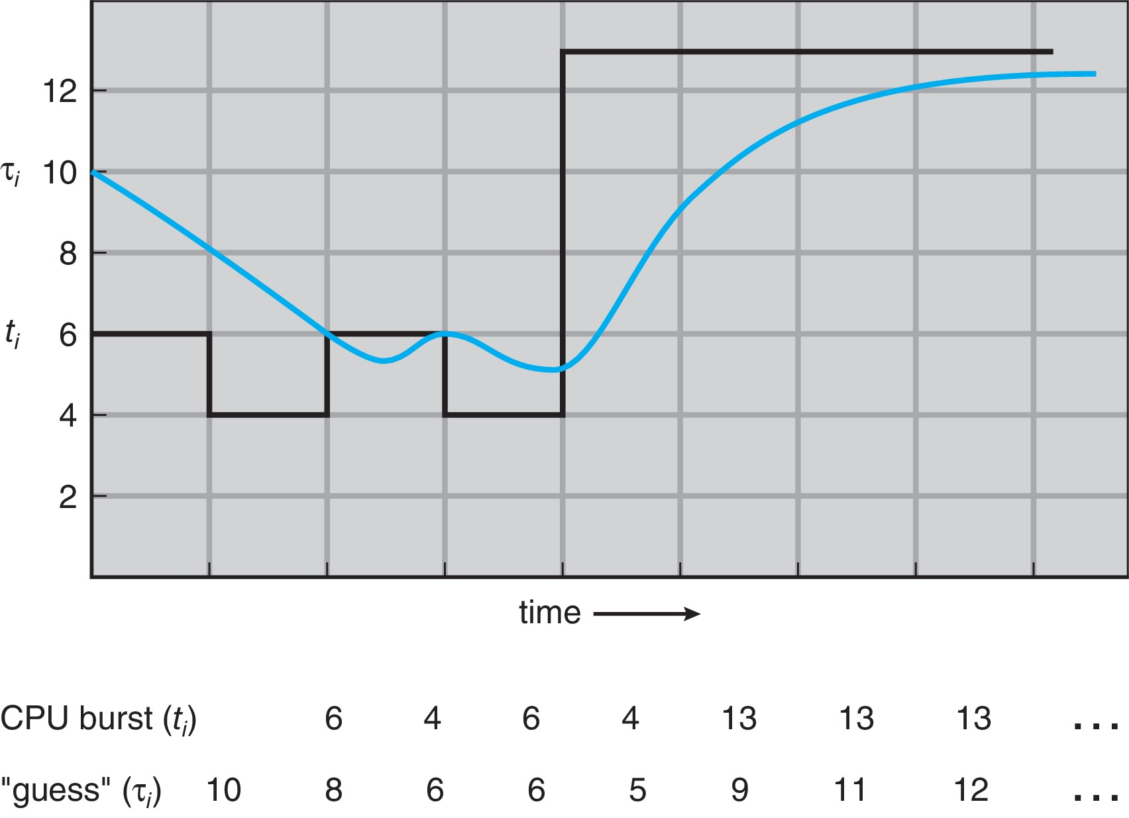
Prediction of the Length of the Next CPU Burst

Slide 16
Examples of Exponential Averaging
α =0
τ_{n+1} = τ_{n}
Recent history does not count
α =1
τ_{n+1} = α t_{n}
Only the actual last CPU burst counts
If we expand the formula, we get:
τ_{n+1} = α t_{n}+(1 - α)α t_{n} ₋₁ + …
+(1 - α )^{j} α t_{n} _{-j} + …
+(1 - α )^{n +1} τ₀
Since both α and (1 - α) are less than or equal to 1, each successive term has less weight than its predecessor

Slide 17
Example of Shortest-remaining-time-first
Now we add the concepts of varying arrival times and preemption to the analysis
ProcessA arri Arrival TimeT Burst Time
P₁ 0 8
P₂ 1 4
P₃ 2 9
P₄ 3 5
Preemptive SJF Gantt Chart
Average waiting time = [(10-1)+(1-1)+(17-2)+(5-3)]/4 = 26/4 = 6.5 msec

Slide 18
Round Robin (RR)
Each process gets a small unit of CPU time (time quantum q), usually 10-100 milliseconds. After this time has elapsed, the process is preempted and added to the end of the ready queue.
If there are n processes in the ready queue and the time quantum is q, then each process gets 1/n of the CPU time in chunks of at most q time units at once. No process waits more than (n-1)q time units.
Timer interrupts every quantum to schedule next process
Performance
q large ⇒ FIFO
q small ⇒ q must be large with respect to context switch, otherwise overhead is too high

Slide 19
Example of RR with Time Quantum = 4
Process Burst Time
P₁ 24
P₂ 3
P₃ 3
The Gantt chart is:
Typically, higher average turnaround than SJF, but better response
q should be large compared to context switch time
q usually 10ms to 100ms, context switch < 10 usec

Slide 20
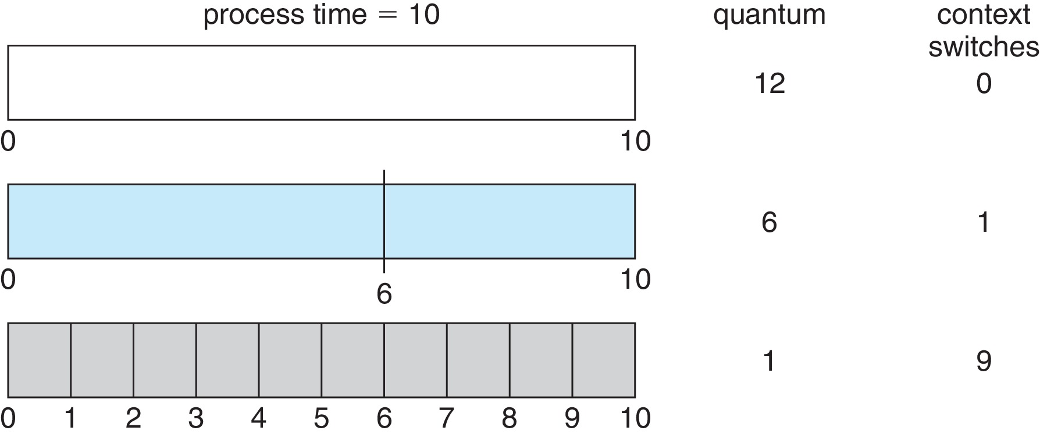
Time Quantum and Context Switch Time

Slide 21
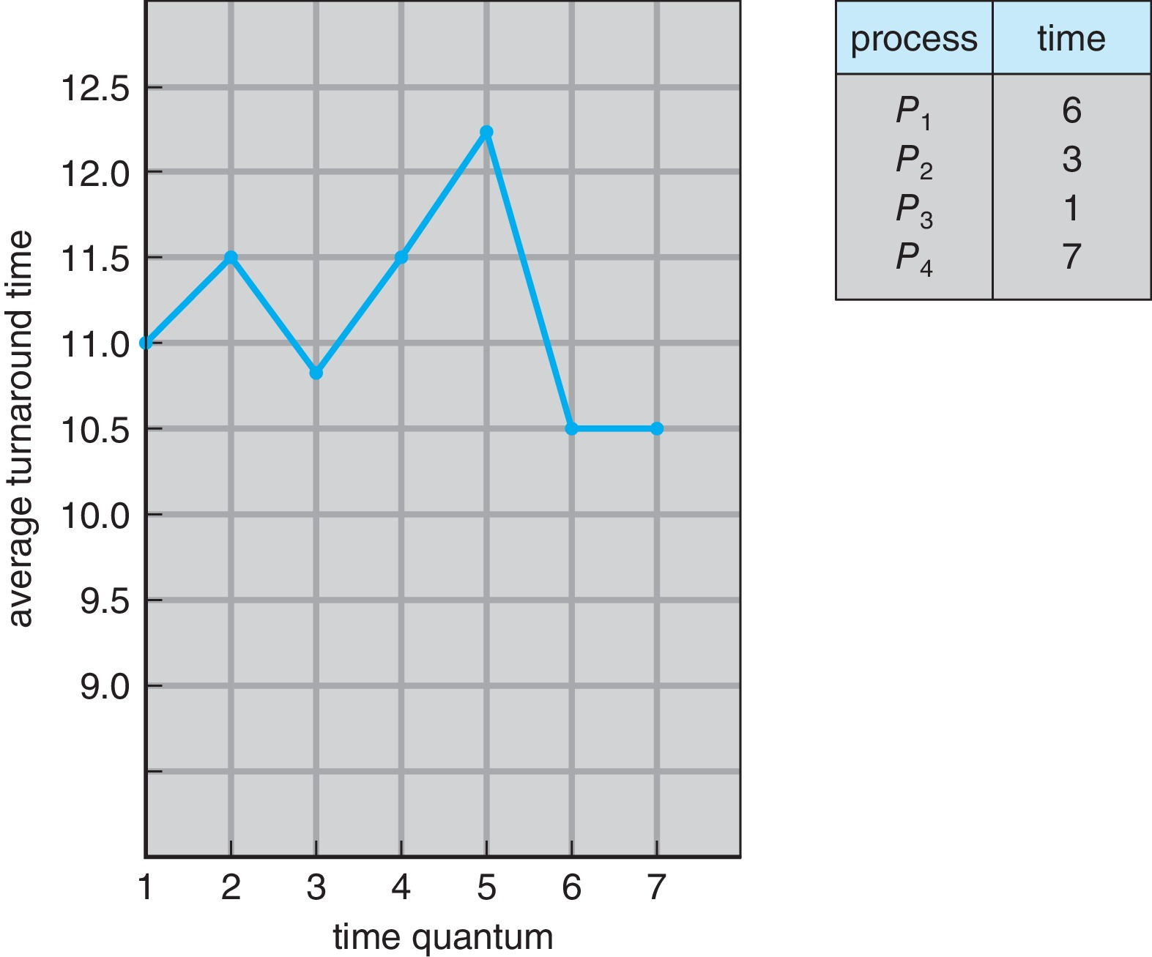
Turnaround Time Varies With The Time Quantum
80% of CPU bursts should be shorter than q

Slide 22
Priority Scheduling
A priority number (integer) is associated with each process
The CPU is allocated to the process with the highest priority (smallest integer ≡ highest priority)
Preemptive
Nonpreemptive
SJF is priority scheduling where priority is the inverse of predicted next CPU burst time
Problem ≡ Starvation – low priority processes may never execute
Solution ≡ Aging – as time progresses increase the priority of the process

Slide 23
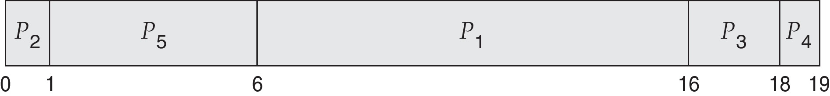
Example of Priority Scheduling
ProcessA arri Burst TimeT Priority
P₁ 10 3
P₂ 1 1
P₃ 2 4
P₄ 1 5
P₅ 5 2
Priority scheduling Gantt Chart
Average waiting time = 8.2 msec

Slide 24
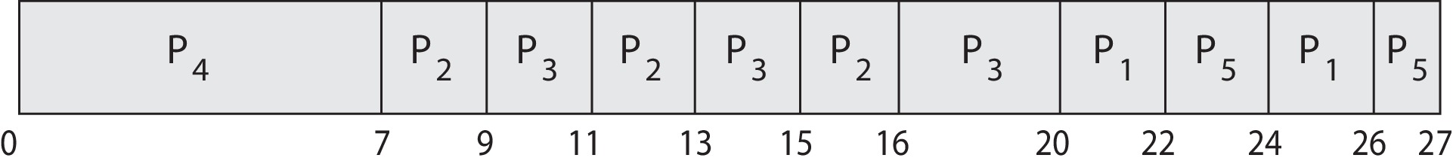
Priority Scheduling w/ Round-Robin
ProcessA arri Burst TimeT Priority
P₁ 4 3
P₂ 5 2
P₃ 8 2
P₄ 7 1
P₅ 3 3
Run the process with the highest priority. Processes with the same priority run round-robin
Gantt Chart wit 2 ms time quantum

Slide 25
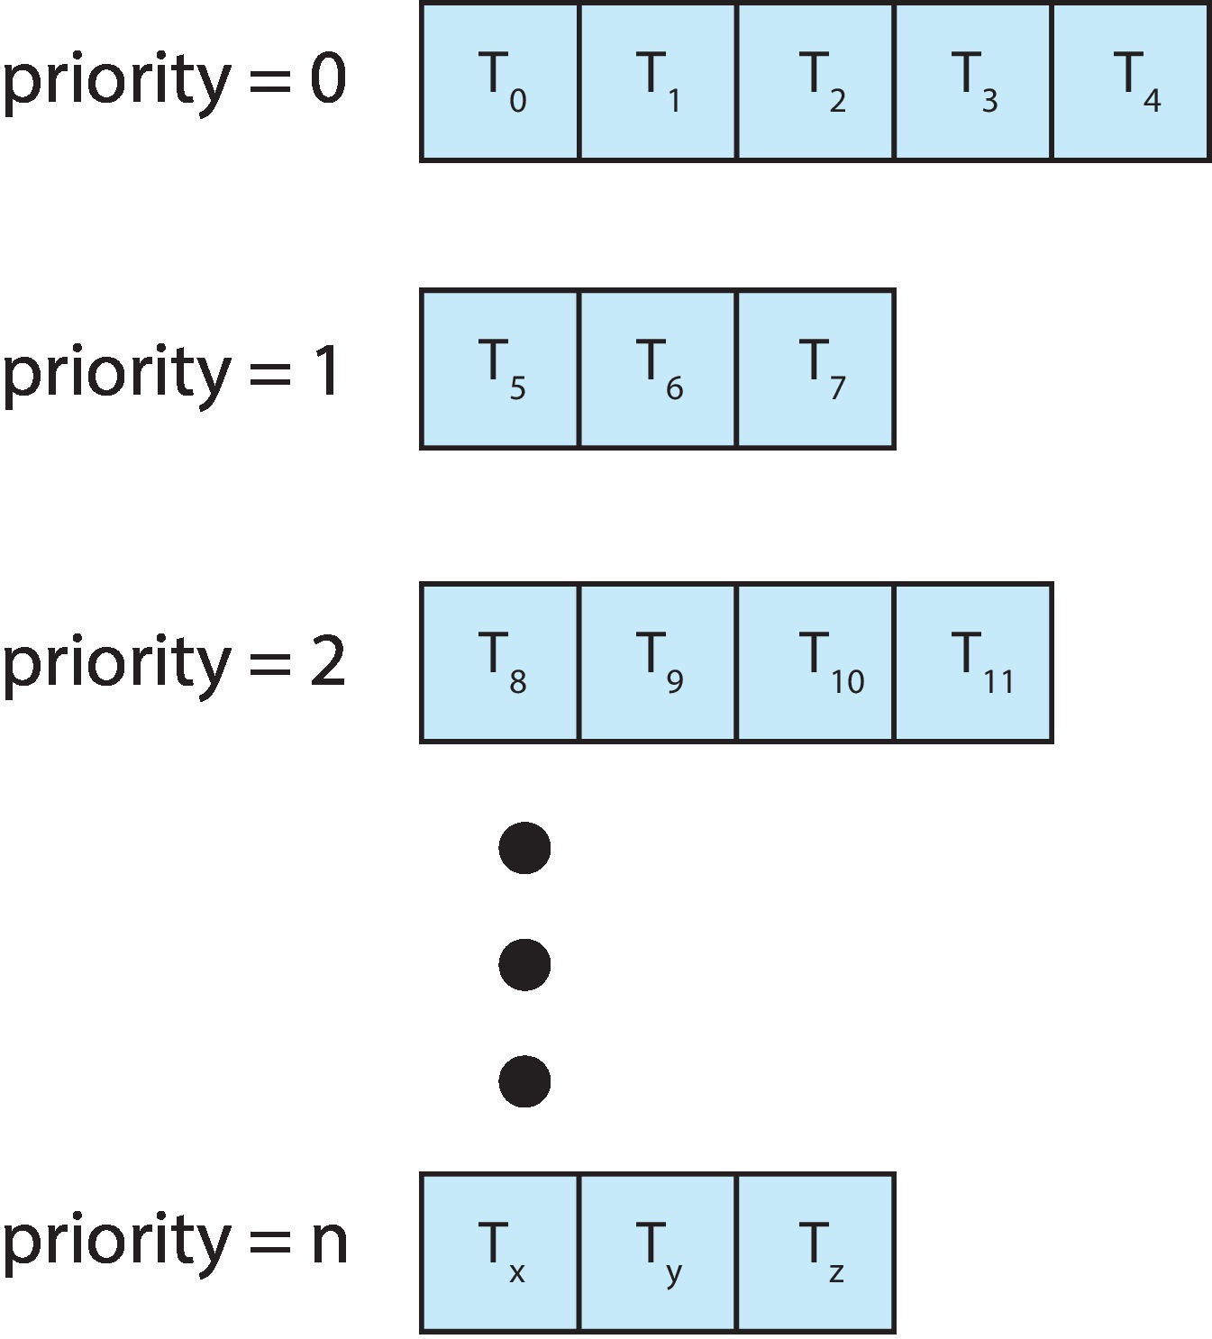
Multilevel Queue
With priority scheduling, have separate queues for each priority.
Schedule the process in the highest-priority queue!

Slide 26
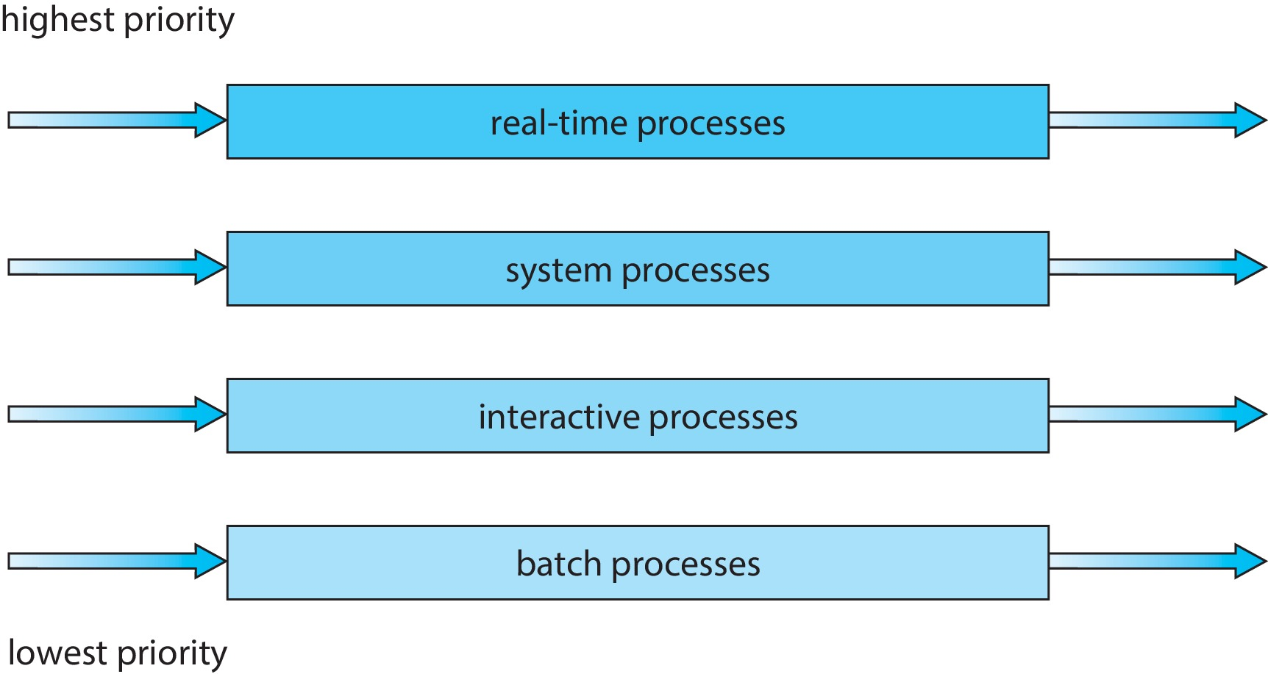
Multilevel Queue
Prioritization based upon process type

Slide 27
Multilevel Feedback Queue
A process can move between the various queues; aging can be implemented this way
Multilevel-feedback-queue scheduler defined by the following parameters:
number of queues
scheduling algorithms for each queue
method used to determine when to upgrade a process
method used to determine when to demote a process
method used to determine which queue a process will enter when that process needs service

Slide 28
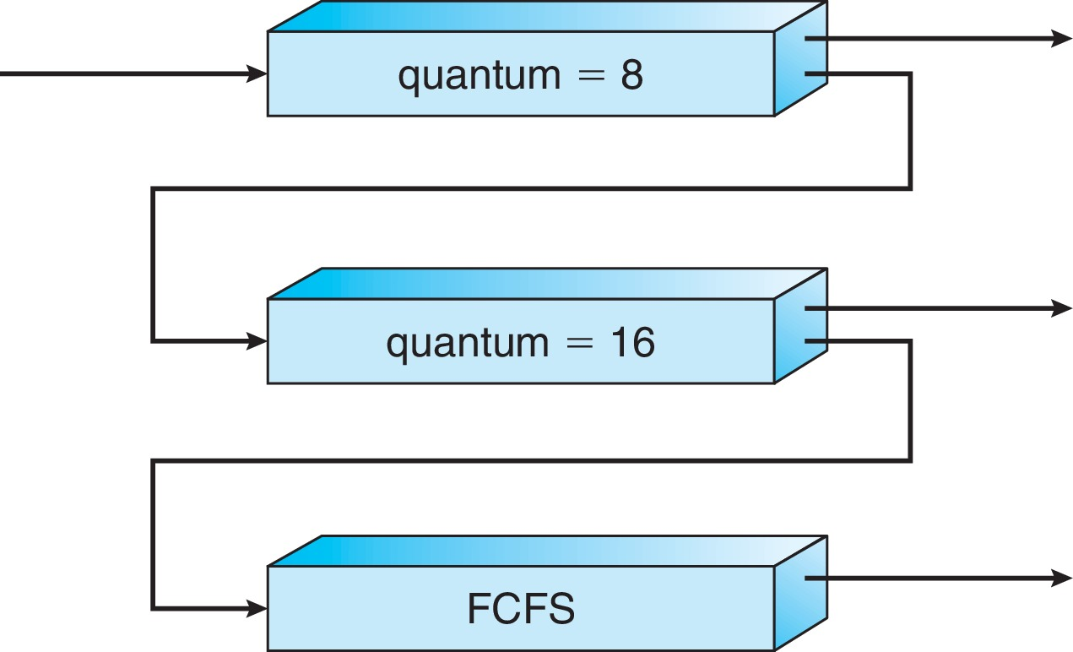
Example of Multilevel Feedback Queue
Three queues:
Q₀ – RR with time quantum 8 milliseconds
Q₁ – RR time quantum 16 milliseconds
Q₂ – FCFS
Scheduling
A new job enters queue Q₀ which is served FCFS
When it gains CPU, job receives 8 milliseconds
If it does not finish in 8 milliseconds, job is moved to queue Q₁
At Q₁ job is again served FCFS and receives 16 additional milliseconds
If it still does not complete, it is preempted and moved to queue Q₂

Slide 29
Thread Scheduling
Distinction between user-level and kernel-level threads
When threads supported, threads scheduled, not processes
Many-to-one and many-to-many models, thread library schedules user-level threads to run on LWP
Known as process-contention scope (PCS) since scheduling competition is within the process
Typically done via priority set by programmer
Kernel thread scheduled onto available CPU is system-contention scope (SCS) – competition among all threads in system

Slide 30
Pthread Scheduling
API allows specifying either PCS or SCS during thread creation
PTHREAD_SCOPE_PROCESS schedules threads using PCS scheduling
PTHREAD_SCOPE_SYSTEM schedules threads using SCS scheduling
Can be limited by OS – Linux and macOS only allow PTHREAD_SCOPE_SYSTEM

Slide 31
Pthread Scheduling API
#include <pthread.h>
#include <stdio.h>
#define NUM_THREADS 5
int main(int argc, char *argv[]) {
int i, scope; pthread_t tid[NUM THREADS];
pthread_attr_t attr;
/* get the default attributes */
pthread_attr_init(&attr);
/* first inquire on the current scope */ if (pthread_attr_getscope(&attr, &scope) != 0)
fprintf(stderr, "Unable to get scheduling scope\n");
else {
if (scope == PTHREAD_SCOPE_PROCESS)
printf("PTHREAD_SCOPE_PROCESS");
else if (scope == PTHREAD_SCOPE_SYSTEM)
printf("PTHREAD_SCOPE_SYSTEM");
else fprintf(stderr, "Illegal scope value.\n");
}

Slide 32
Pthread Scheduling API
/* set the scheduling algorithm to PCS or SCS */
pthread_attr_setscope(&attr, PTHREAD_SCOPE_SYSTEM);
/* create the threads */ for (i = 0; i < NUM_THREADS; i++)
pthread_create(&tid[i],&attr,runner,NULL);
/* now join on each thread */ for (i = 0; i < NUM_THREADS; i++)
pthread_join(tid[i], NULL);
}
/* Each thread will begin control in this function */
void *runner(void *param) {
/* do some work ... */
pthread_exit(0);
}

Slide 33
Multiple-Processor Scheduling
CPU scheduling more complex when multiple CPUs are available
Multiprocess may be any one of the following architectures:
Multicore CPUs
Multithreaded cores
NUMA systems
Heterogeneous multiprocessing

Slide 34
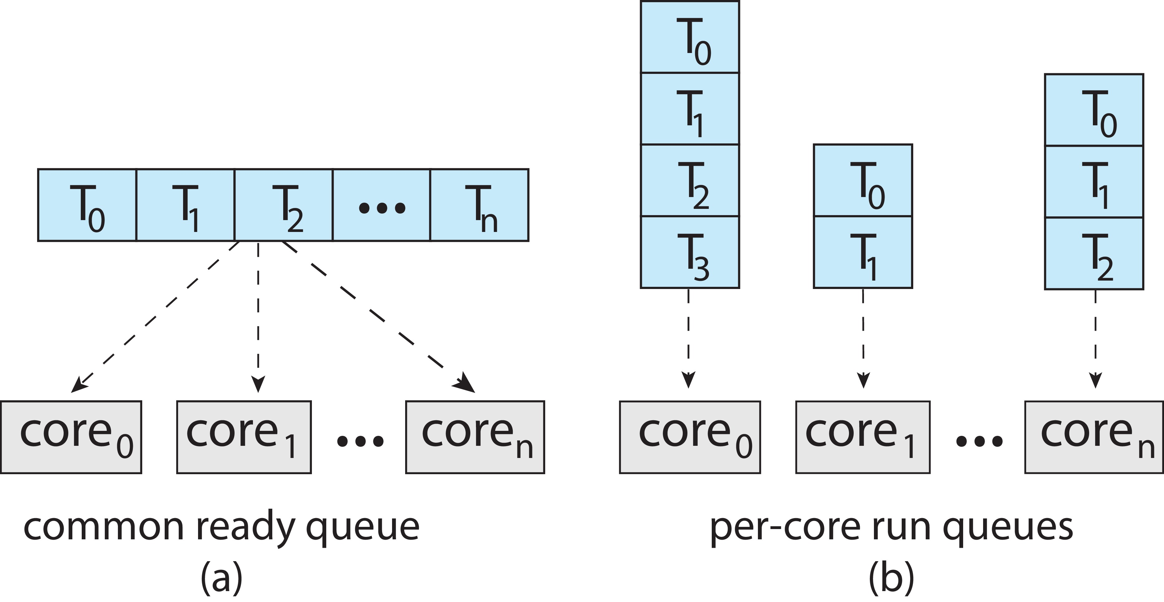
Multiple-Processor Scheduling
Symmetric multiprocessing (SMP) is where each processor is self scheduling.
All threads may be in a common ready queue (a)
Each processor may have its own private queue of threads (b)

Slide 35
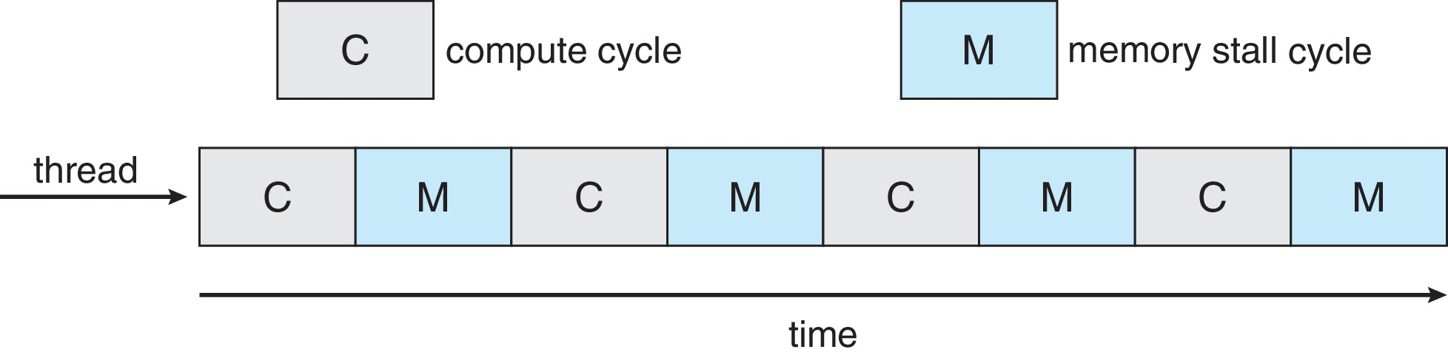
Multicore Processors
Recent trend to place multiple processor cores on same physical chip
Faster and consumes less power
Multiple threads per core also growing
Takes advantage of memory stall to make progress on another thread while memory retrieve happens

Slide 36
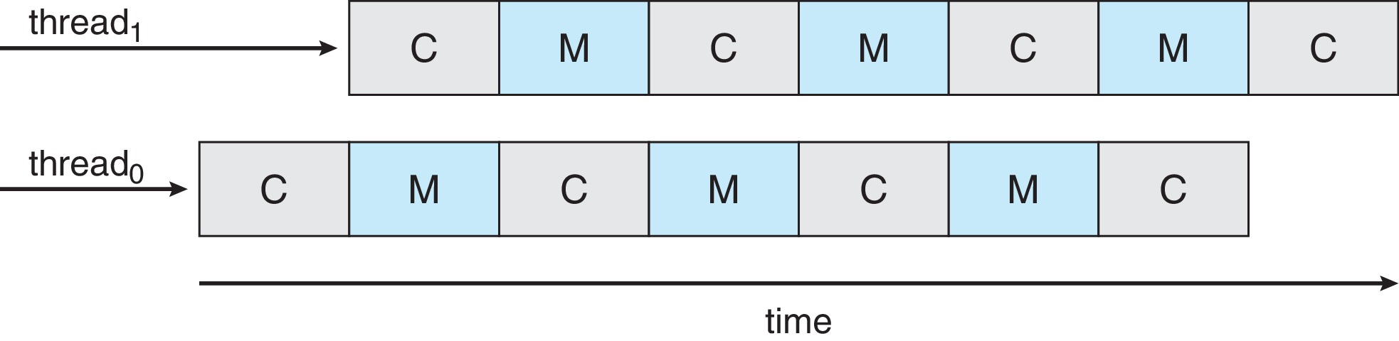
Multithreaded Multicore System
Each core has > 1 hardware threads.
If one thread has a memory stall, switch to another thread!

Slide 37
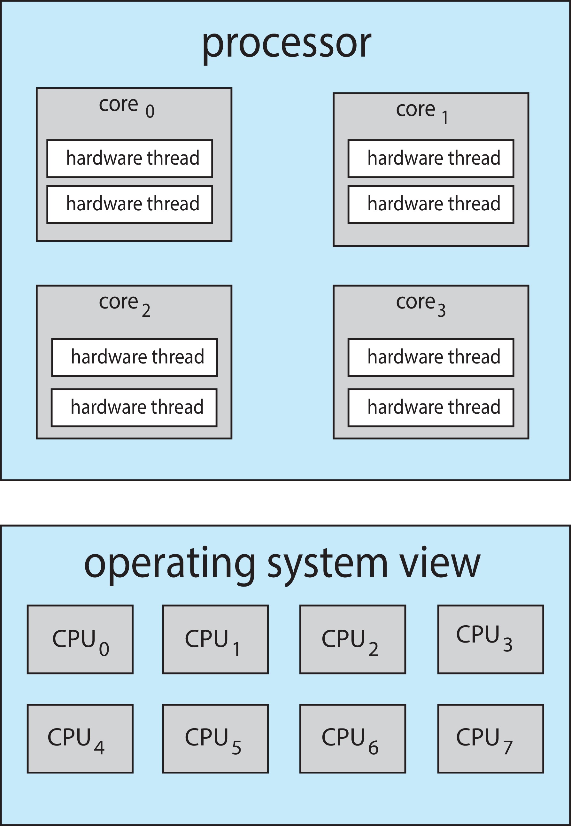
Multithreaded Multicore System
Chip-multithreading (CMT) assigns each core multiple hardware threads. (Intel refers to this as hyperthreading.)
On a quad-core system with 2 hardware threads per core, the operating system sees 8 logical processors.

Slide 38
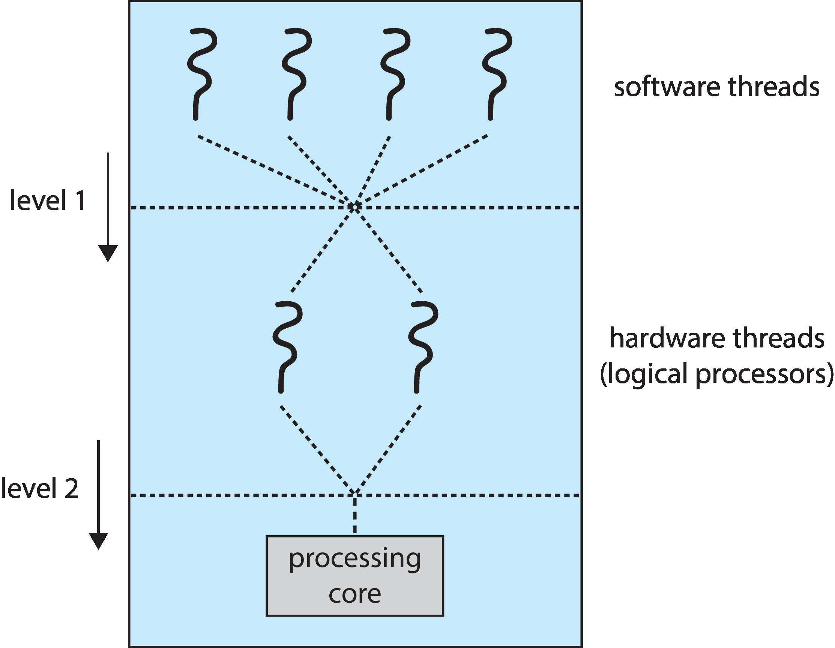
Multithreaded Multicore System
Two levels of scheduling:
The operating system deciding which software thread to run on a logical CPU
How each core decides which hardware thread to run on the physical core.

Slide 39
Multiple-Processor Scheduling – Load Balancing
If SMP, need to keep all CPUs loaded for efficiency
Load balancing attempts to keep workload evenly distributed
Push migration – periodic task checks load on each processor, and if found pushes task from overloaded CPU to other CPUs
Pull migration – idle processors pulls waiting task from busy processor

Slide 40
Multiple-Processor Scheduling – Processor Affinity
When a thread has been running on one processor, the cache contents of that processor stores the memory accesses by that thread.
We refer to this as a thread having affinity for a processor (i.e., “processor affinity”)
Load balancing may affect processor affinity as a thread may be moved from one processor to another to balance loads, yet that thread loses the contents of what it had in the cache of the processor it was moved off of.
Soft affinity – the operating system attempts to keep a thread running on the same processor, but no guarantees.
Hard affinity – allows a process to specify a set of processors it may run on.

Slide 41
NUMA and CPU Scheduling
If the operating system is NUMA-aware, it will assign memory closes to the CPU the thread is running on.

Slide 42
Real-Time CPU Scheduling
Can present obvious challenges
Soft real-time systems – Critical real-time tasks have the highest priority, but no guarantee as to when tasks will be scheduled
Hard real-time systems – task must be serviced by its deadline

Slide 43
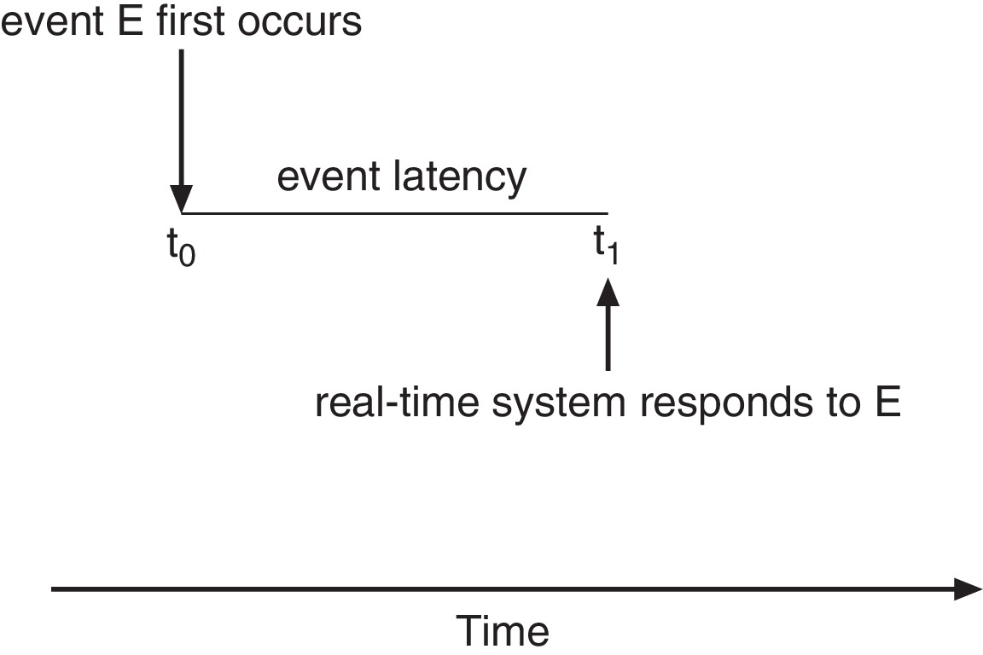
Real-Time CPU Scheduling
Event latency – the amount of time that elapses from when an event occurs to when it is serviced.
Two types of latencies affect performance
Interrupt latency – time from arrival of interrupt to start of routine that services interrupt
Dispatch latency – time for schedule to take current process off CPU and switch to another

Slide 44
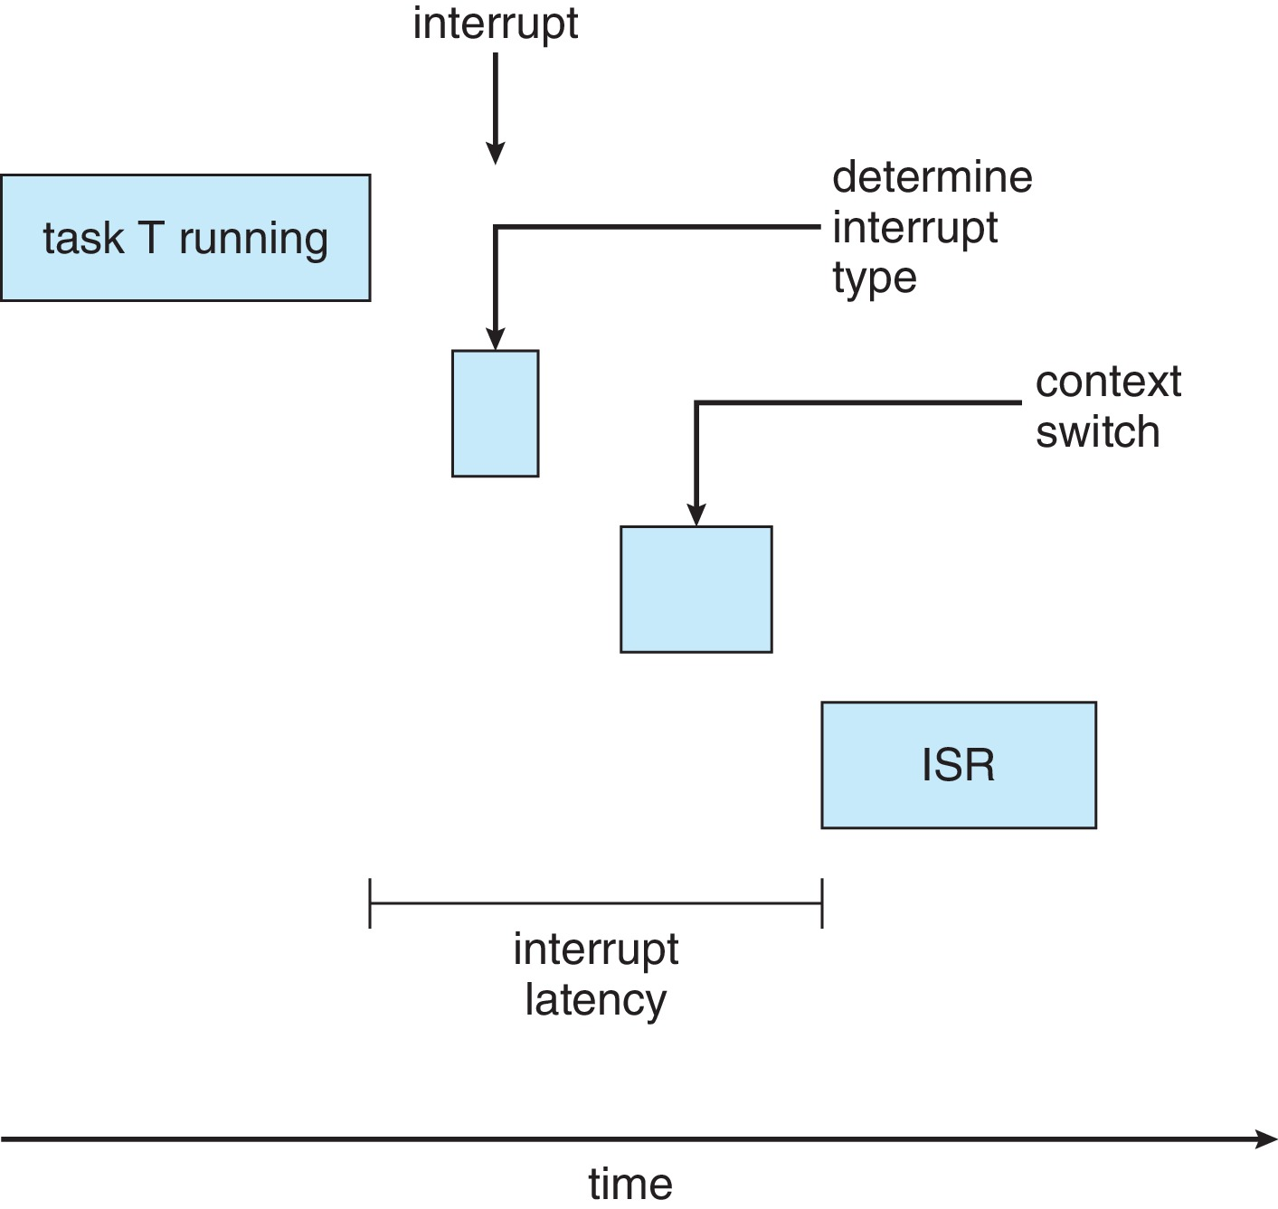
Interrupt Latency

Slide 45
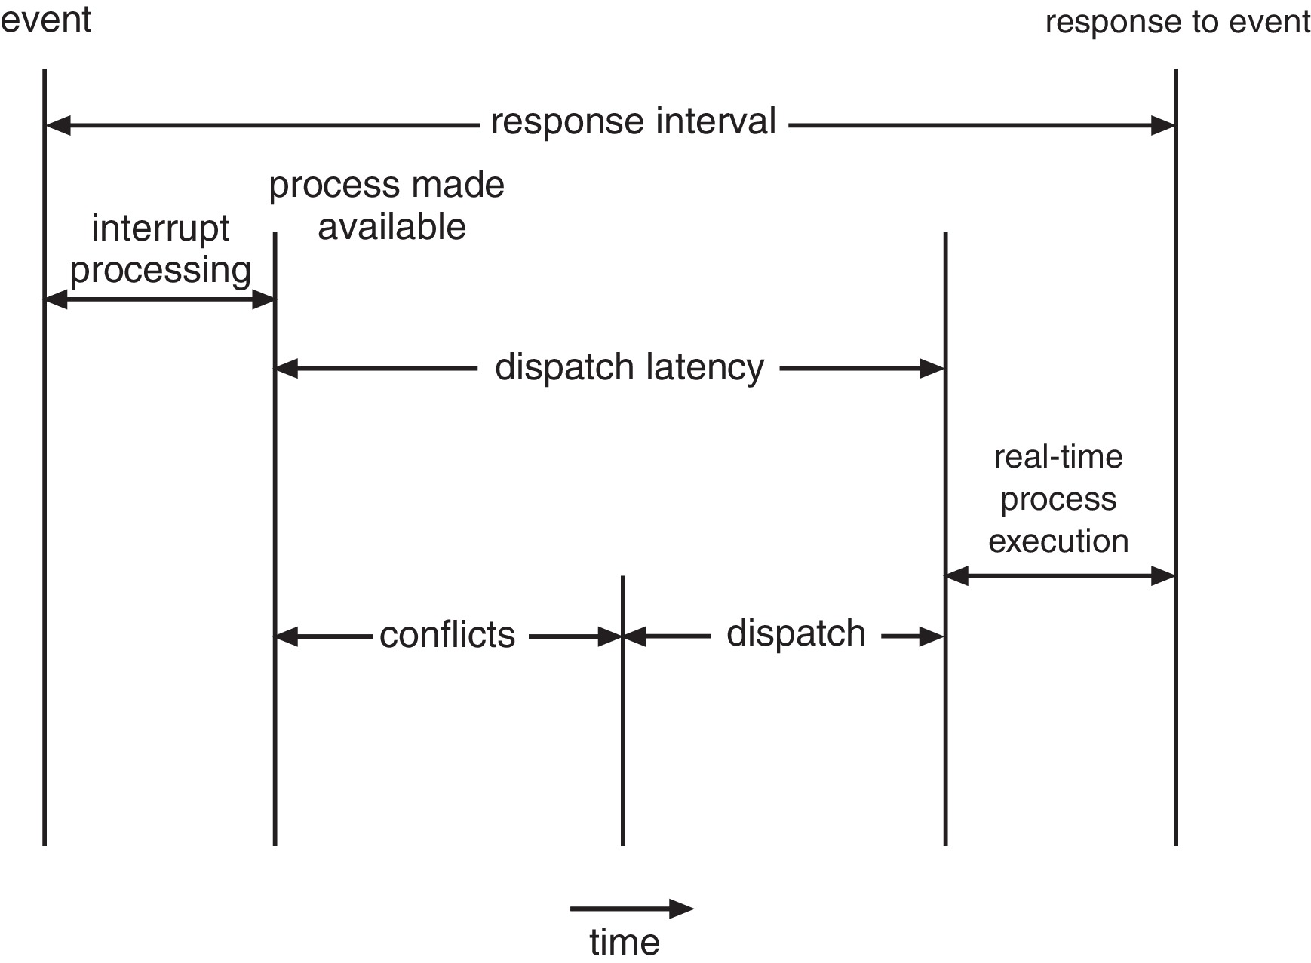
Dispatch Latency
Conflict phase of dispatch latency:
Preemption of any process running in kernel mode
Release by low-priority process of resources needed by high-priority processes

Slide 46
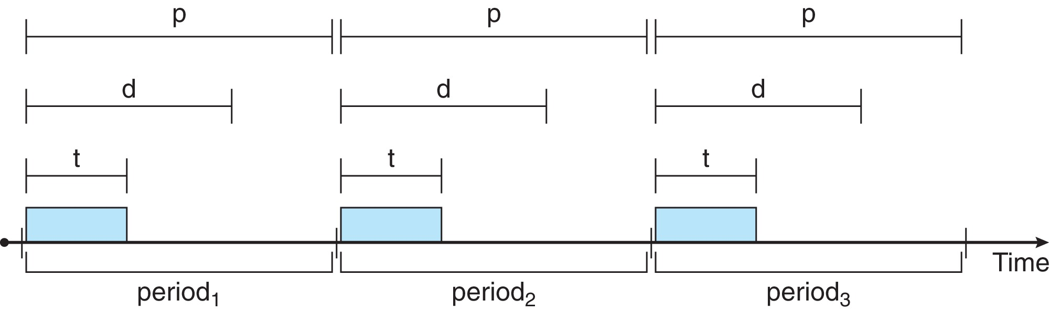
Priority-based Scheduling
For real-time scheduling, scheduler must support preemptive, priority-based scheduling
But only guarantees soft real-time
For hard real-time must also provide ability to meet deadlines
Processes have new characteristics: periodic ones require CPU at constant intervals
Has processing time t, deadline d, period p
0 ≤ t ≤ d ≤ p
Rate of periodic task is 1/p

Slide 47
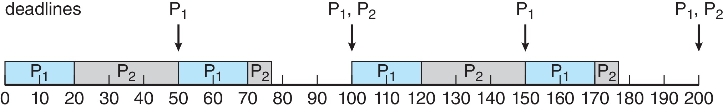
Rate Montonic Scheduling
A priority is assigned based on the inverse of its period
Shorter periods = higher priority;
Longer periods = lower priority
P₁ is assigned a higher priority than P₂.

Slide 48
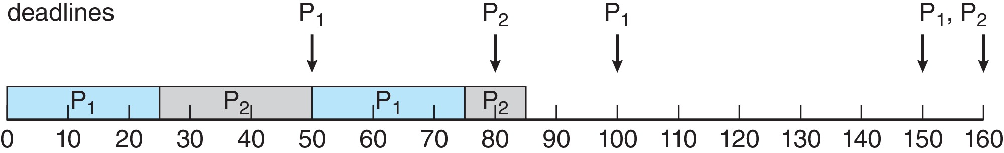
Missed Deadlines with Rate Monotonic Scheduling
Process P2 misses finishing its deadline at time 80

Slide 49
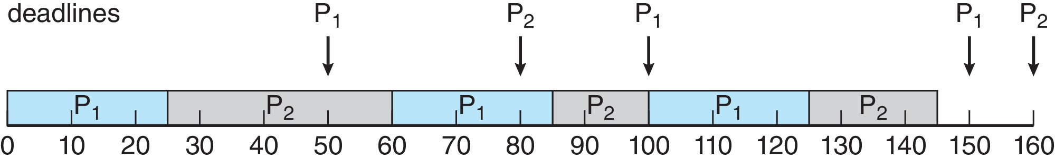
Earliest Deadline First Scheduling (EDF)
Priorities are assigned according to deadlines: the earlier the deadline, the higher the priority;
the later the deadline, the lower the priority

Slide 50
Proportional Share Scheduling
T shares are allocated among all processes in the system
An application receives N shares where N < T
This ensures each application will receive N / T of the total processor time

Slide 51
POSIX Real-Time Scheduling
The POSIX.1b standard
API provides functions for managing real-time threads
Defines two scheduling classes for real-time threads:
SCHED_FIFO - threads are scheduled using a FCFS strategy with a FIFO queue. There is no time-slicing for threads of equal priority
SCHED_RR - similar to SCHED_FIFO except time-slicing occurs for threads of equal priority
Defines two functions for getting and setting scheduling policy:
pthread_attr_getsched_policy(pthread_attr_t *attr, int *policy)
pthread_attr_setsched_policy(pthread_attr_t *attr, int policy)

Slide 52
POSIX Real-Time Scheduling API
#include <pthread.h>
#include <stdio.h>
#define NUM_THREADS 5
int main(int argc, char *argv[])
{
int i, policy; pthread_t_tid[NUM_THREADS];
pthread_attr_t attr;
/* get the default attributes */
pthread_attr_init(&attr);
/* get the current scheduling policy */ if (pthread_attr_getschedpolicy(&attr, &policy) != 0)
fprintf(stderr, "Unable to get policy.\n");
else {
if (policy == SCHED_OTHER) printf("SCHED_OTHER\n");
else if (policy == SCHED_RR) printf("SCHED_RR\n");
else if (policy == SCHED_FIFO) printf("SCHED_FIFO\n");
}

Slide 53
POSIX Real-Time Scheduling API (Cont.)
/* set the scheduling policy - FIFO, RR, or OTHER */ if (pthread_attr_setschedpolicy(&attr, SCHED_FIFO) != 0)
fprintf(stderr, "Unable to set policy.\n");
/* create the threads */ for (i = 0; i < NUM_THREADS; i++)
pthread_create(&tid[i],&attr,runner,NULL);
/* now join on each thread */ for (i = 0; i < NUM_THREADS; i++)
pthread_join(tid[i], NULL);
}
/* Each thread will begin control in this function */
void *runner(void *param) {
/* do some work ... */
pthread_exit(0);
}

Slide 54
Windows Scheduling
Windows uses priority-based preemptive scheduling
Highest-priority thread runs next
Dispatcher is scheduler
Thread runs until (1) blocks, (2) uses time slice, (3) preempted by higher-priority thread
Real-time threads can preempt non-real-time
32-level priority scheme
Variable class is 1-15, real-time class is 16-31
Priority 0 is memory-management thread
Queue for each priority
If no run-able thread, runs idle thread

Slide 55
Windows Priority Classes
Win32 API identifies several priority classes to which a process can belong
REALTIME_PRIORITY_CLASS, HIGH_PRIORITY_CLASS, ABOVE_NORMAL_PRIORITY_CLASS,NORMAL_PRIORITY_CLASS, BELOW_NORMAL_PRIORITY_CLASS, IDLE_PRIORITY_CLASS
All are variable except REALTIME
A thread within a given priority class has a relative priority
TIME_CRITICAL, HIGHEST, ABOVE_NORMAL, NORMAL, BELOW_NORMAL, LOWEST, IDLE
Priority class and relative priority combine to give numeric priority
Base priority is NORMAL within the class
If quantum expires, priority lowered, but never below base

Slide 56
Windows Priority Classes (Cont.)
If wait occurs, priority boosted depending on what was waited for
Foreground window given 3x priority boost
Windows 7 added user-mode scheduling (UMS)
Applications create and manage threads independent of kernel
For large number of threads, much more efficient
UMS schedulers come from programming language libraries like C++ Concurrent Runtime (ConcRT) framework

Slide 57
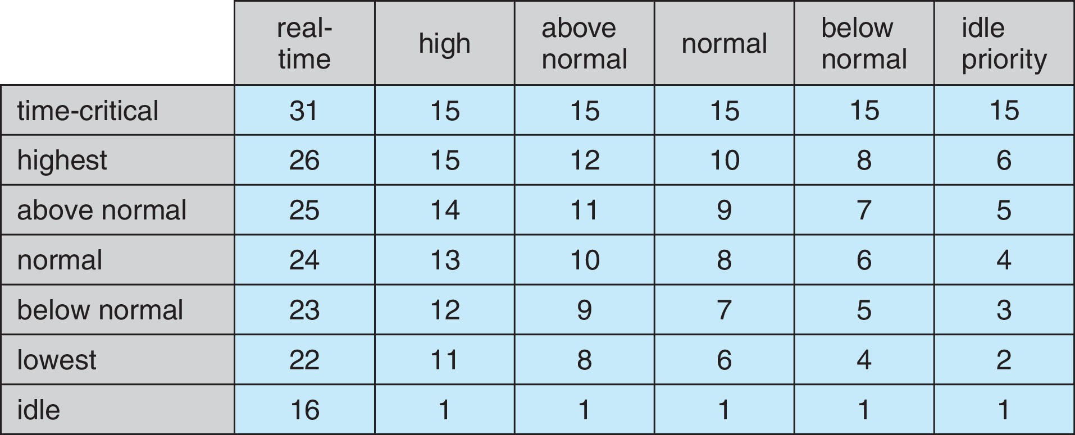
Windows Priorities

Slide 58
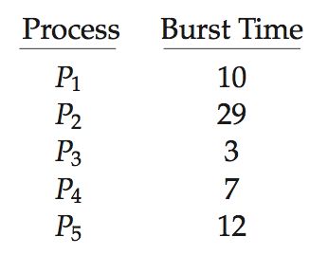
Algorithm Evaluation
How to select CPU-scheduling algorithm for an OS?
Determine criteria, then evaluate algorithms
Deterministic modeling
Type of analytic evaluation
Takes a particular predetermined workload and defines the performance of each algorithm for that workload
Consider 5 processes arriving at time 0:

Slide 59
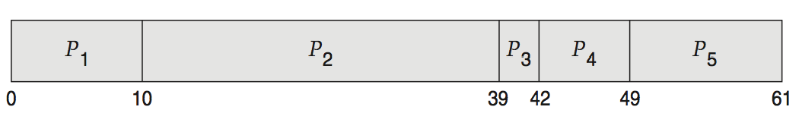
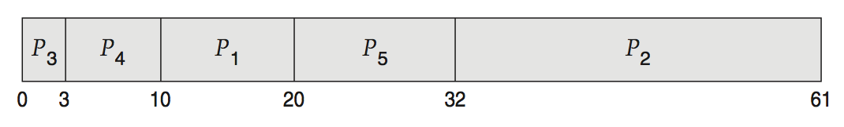
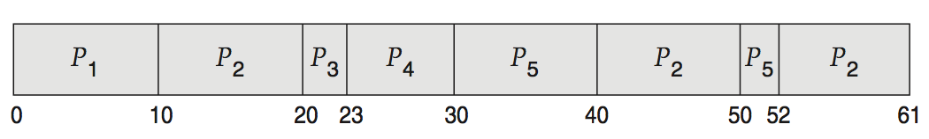
Deterministic Evaluation
For each algorithm, calculate minimum average waiting time
Simple and fast, but requires exact numbers for input, applies only to those inputs
FCS is 28ms:
Non-preemptive SFJ is 13ms:
RR is 23ms:

Slide 60
Queueing Models
Describes the arrival of processes, and CPU and I/O bursts probabilistically
Commonly exponential, and described by mean
Computes average throughput, utilization, waiting time, etc
Computer system described as network of servers, each with queue of waiting processes
Knowing arrival rates and service rates
Computes utilization, average queue length, average wait time, etc

Slide 61
Little’s Formula
n = average queue length
W = average waiting time in queue
λ = average arrival rate into queue
Little’s law – in steady state, processes leaving queue must equal processes arriving, thus: n = λ x W
Valid for any scheduling algorithm and arrival distribution
For example, if on average 7 processes arrive per second, and normally 14 processes in queue, then average wait time per process = 2 seconds

Slide 62
Simulations
Queueing models limited
Simulations more accurate
Programmed model of computer system
Clock is a variable
Gather statistics indicating algorithm performance
Data to drive simulation gathered via
Random number generator according to probabilities
Distributions defined mathematically or empirically
Trace tapes record sequences of real events in real systems

Slide 63
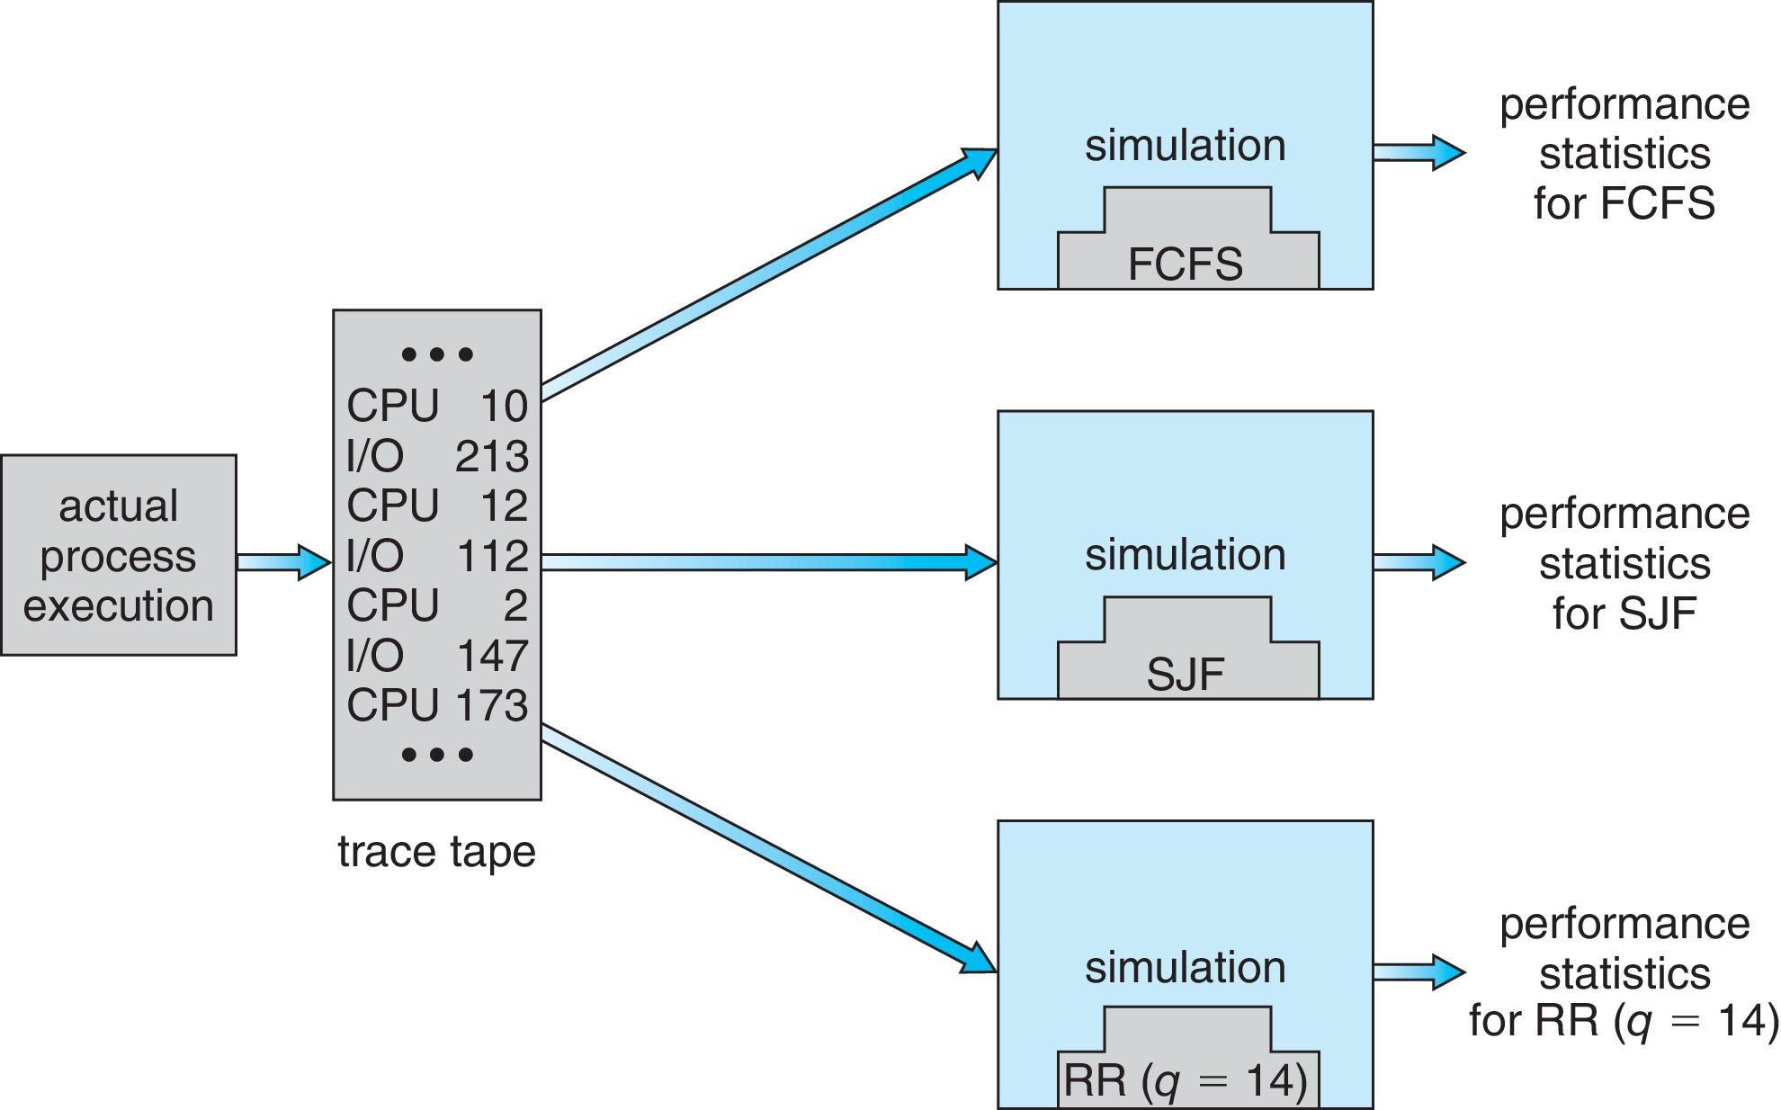
Evaluation of CPU Schedulers by Simulation

Slide 64
Implementation
Even simulations have limited accuracy
Just implement new scheduler and test in real systems
High cost, high risk
Environments vary
Most flexible schedulers can be modified per-site or per-system
Or APIs to modify priorities
But again environments vary

Slide 65
End of Chapter 5

